Slide 1
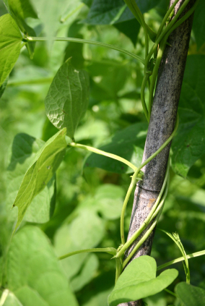
“Ornamental climbers”…

Slide 2
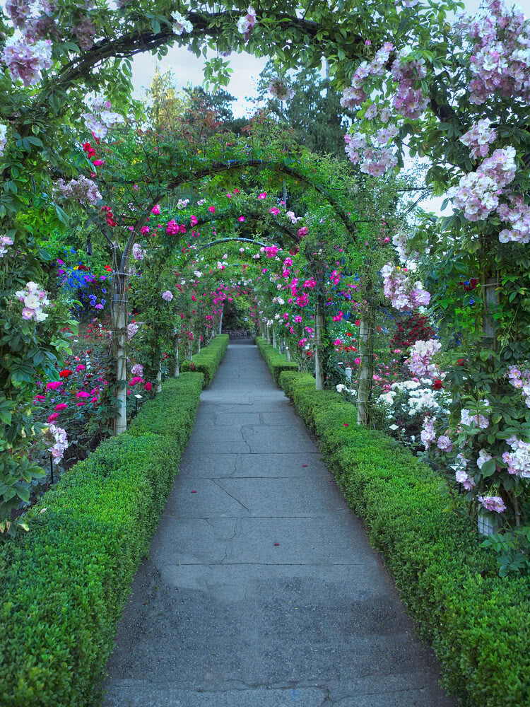

Climbers are a group of plants with weak stem which have ability to climb on the support either through twinning or with the help of special organs like tendrils, hooks etc.

Slide 3
Climbers
Bines / twinners
Vines
  Twin their stem to the support.
  Climb like a rope with touch sensitive stem.
  Rotation may be :
  Clockwise anticlockwise
  Exp : morning glory
  Exp : climbing honey
  : Scarlet runner suckle
  :Bean
  :Clerodendron etc.
These are the climbers with long flexible stems.
The climb by means of
Tendril :Members of vitaceae, bigonniaceae, passiflora.
Adhesive pads : Virginia creeper.
Thorns : Climbing rose
Twinning petiole: Clematis sp. Etc
Vines are of 2 types .
Herbecoius vines Lianas
These are non woody vines these are woody vines with
With herb.stem . Woody stem.
Exp . Morning glory. Exp wisteria , kiwifruit.etc.

Slide 4
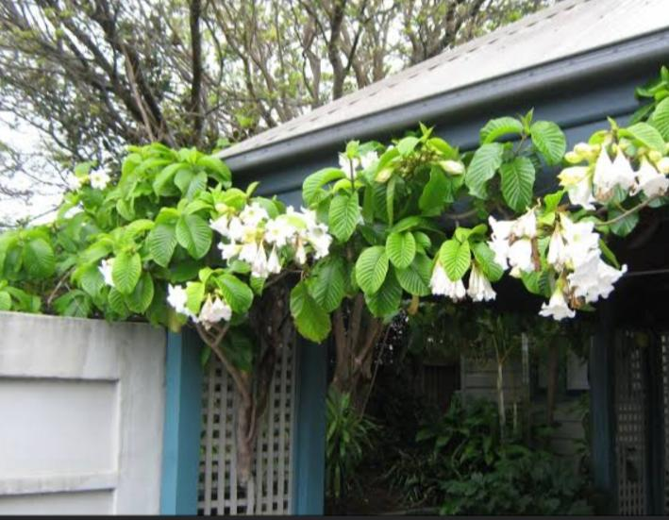
Nepal trumpet flowers
Common name- Easter lily vine
Botanical name – Beaumontia grandiflora
Family – Apcynaceae
Origin – Eastern ghat
Flower colour – white or crimiish white
Flowering – March – April
Remarks – suitable for pergolas , arches and to cover large areas,
Propagation by – air layering.

Slide 5
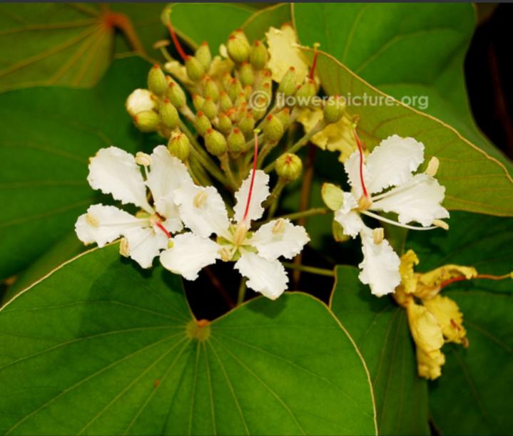
Camel’s foot climber.
Common name – Maloo creeper, bauhinia climber
Botanical name – Bauhinia vahlii
Origin . - western Ghats ( India)
Flower colour –. Yellowish white
Flowering – April June
Remarks - heavy woody climber .
Prop by - seeds

Slide 6
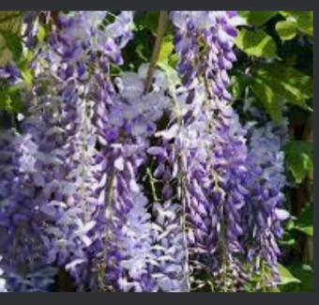
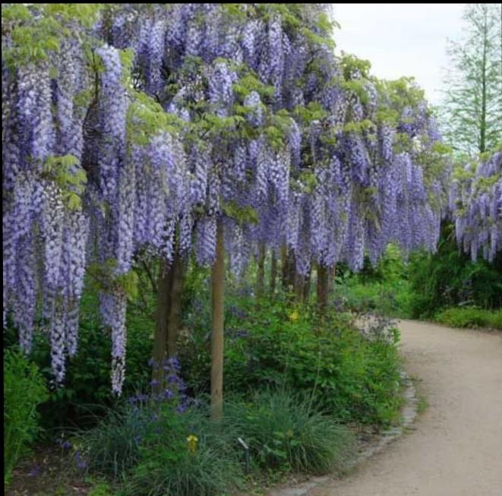
Chinese Wisteria
  Wisteria ( Chinese wisteria)
  Botanical name – Wisteria sinesis
  Family -. Fabaceae
  Origin - China
  Flower colour. - Purple
  Flowering - March to may
  Reamarks It can be propagated through cutting

Slide 7
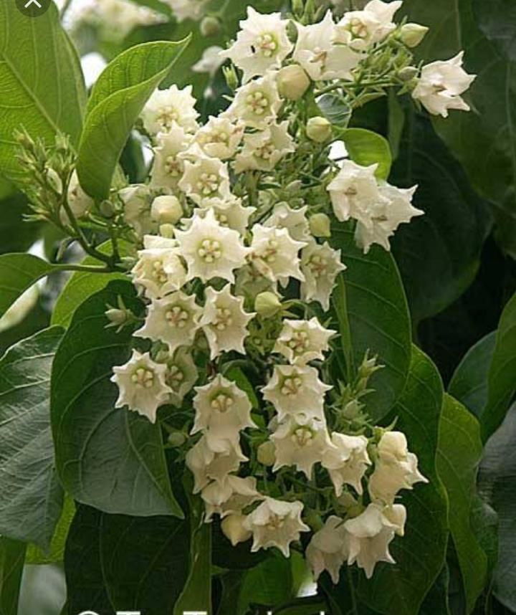
Bread flower (dudhi ke bel)
Botanical name – Vallaris solanaceae
Family - Apocynaceae
Origin - India and Burma
Flower colour- white
Flowering - December-april
Remarks - It can be grown on
pergoals and can also
. Be used as screens.

Slide 8
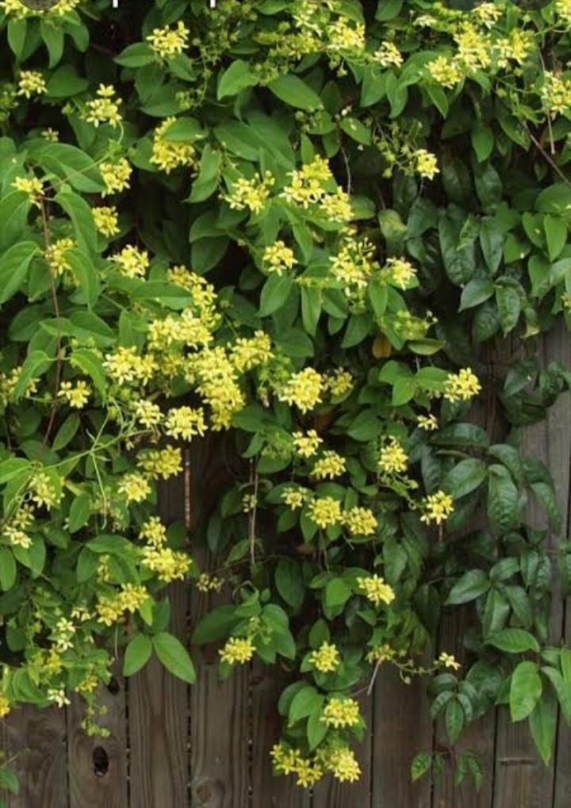
.Australian gold vines
Botanical name – Tristellateia australasian
Faimily - malphighiceae
Origin - Asia to new Caledonia
Flower colour - golden yellow
Remarks - star shaperd flower,small
growing vine.

Slide 9
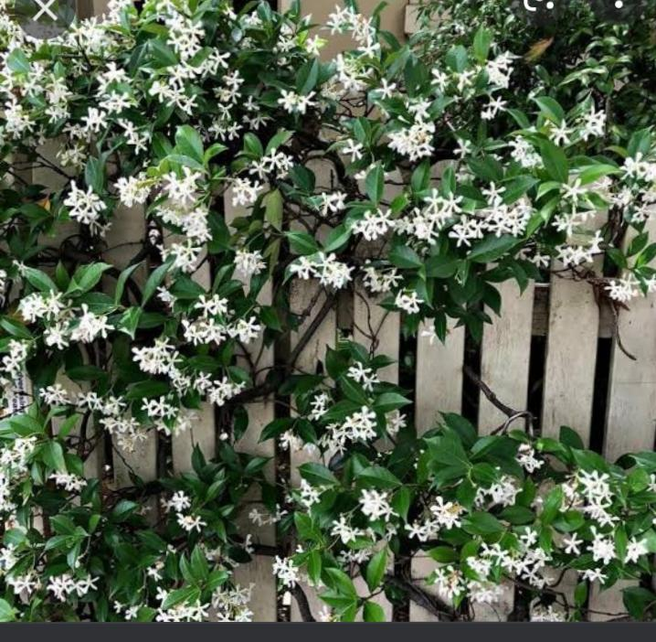
Star jasmine
Botanical name - Trachelospermum jasminiods
Commom name - confederate jasmine
Family - apocynaceae
Origin. - china
Flower colour – white
Flowering - summer
Remarks. -. It can be propagated
Cuttings.

Slide 10
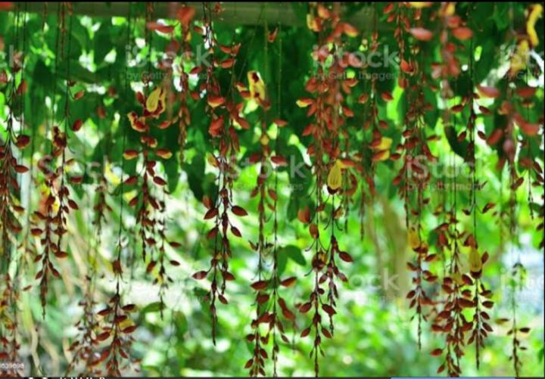
Thunbergia
Common name 👉- Mysore clock vine , Dolls shoes
Botanical name 👉 Thunbergia Mysorensis
Family 👉 acanthaceae .
Origin. 👉 India .
Flower colour 👉 yellow and rust red.
Flowering winter .
Remarks - 👉flowers are large and produced
in long Pendulous interrupted
recemes.
Propagation 👉By Layering.

Slide 11
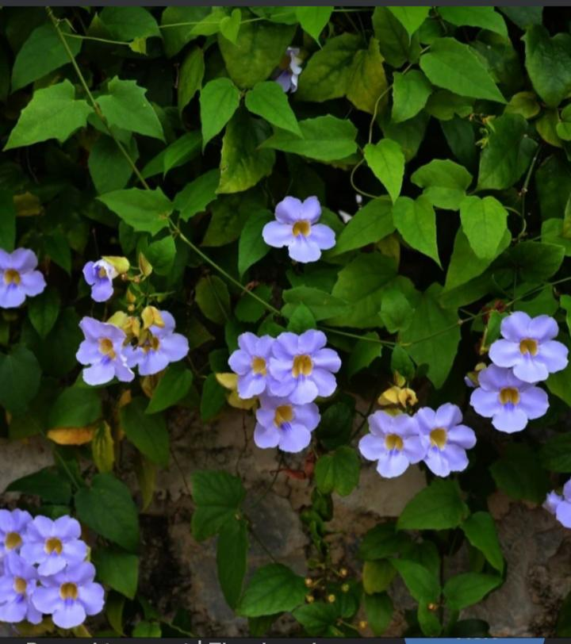
.ThunbeRgia( 2)
Common name --bengal clock vine ,
Blue trumpet vine.
Botanical name– Thunbergia grandiflora
Family - acanthaceae
Origin - Eastern India
Flower colour – Pale blue flower with
cream blue striped centre.
Flowering - Feb.- March and July – sep.
Remarks -. - Suitable for pergolas,
Propagation - by seeds cuttings and layering.

Slide 12
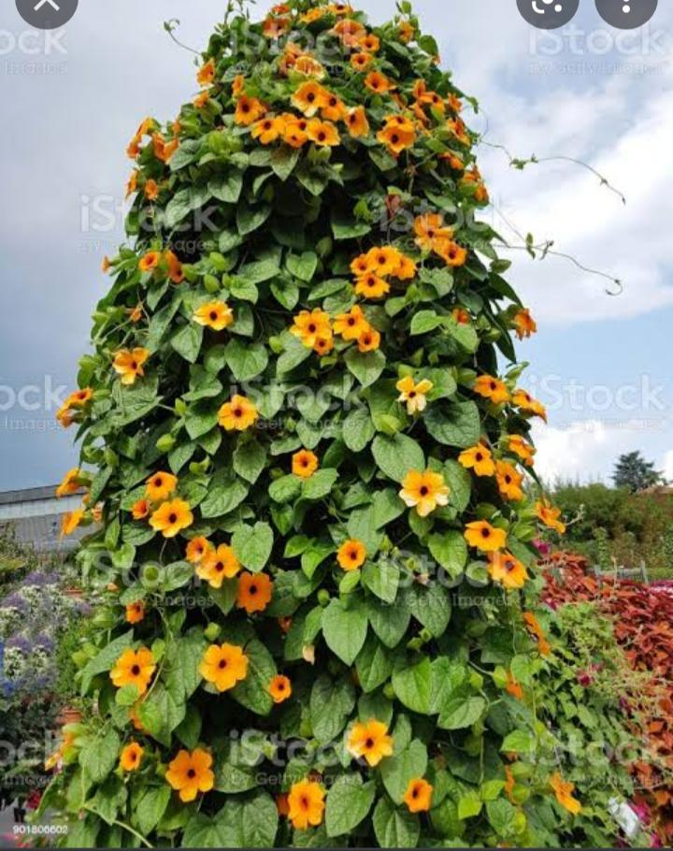
thunbergia (3)
Common name. - Black eyed Susan vine
Botanical name -. Thunbergia alata
Family -. Acanthaceae
Origin -. South Africa
Flower colour – yellow, gold, white, cream.
Flowering. - most of the year
Remarks. - can be propagated
through seed.

Slide 13
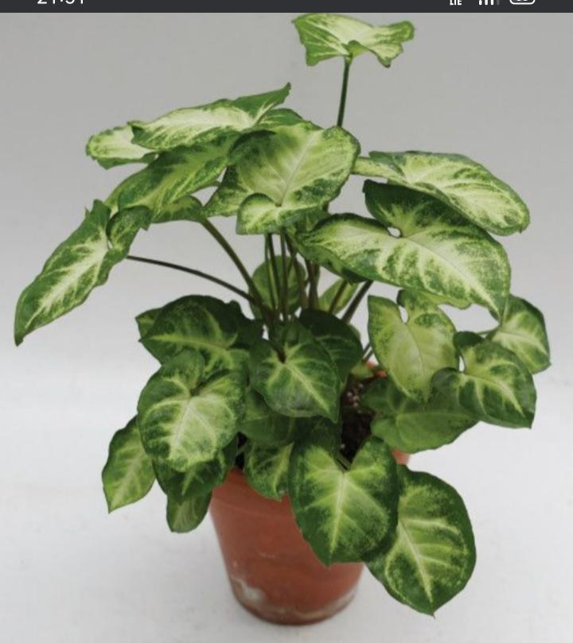
Arrowhead Plant .
Botanical name- Syngonium podophyllum
Family -. Araceae
Origin –. Latin America from Mexico to
Bolivia
Remarks – plants are grown for its beautiful
arrow head shape leaves.

Slide 14
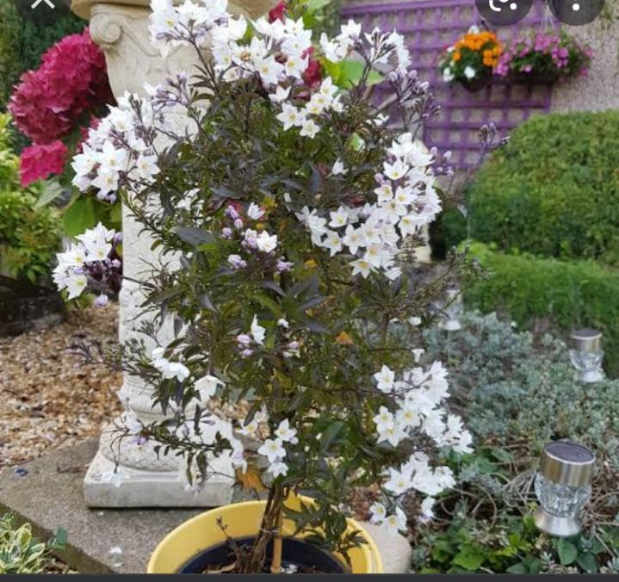
Potato vine
Botanical name – Solanum laxum
Family –. Solanceae
Origin -. South America
Flower colour – white
Remarks – cultivated for fragrant white
flower
Propagation- through cutting or soil
layering

Slide 15
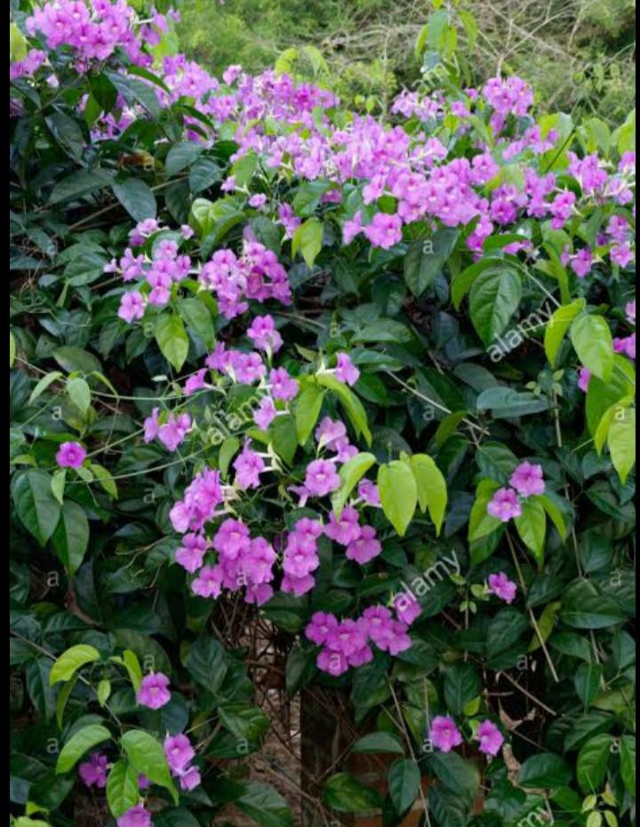
Glow wine
Common name- purple funnel vine, purple
. Bigonia.
Botanical name- Saritaea magnifica
Family. -bignoniaceae
Origin – south america.
Flower colour- purple with white throat.
Flowering –. sept.- November
Remarks- propagation by cutting and
layering.

Slide 16
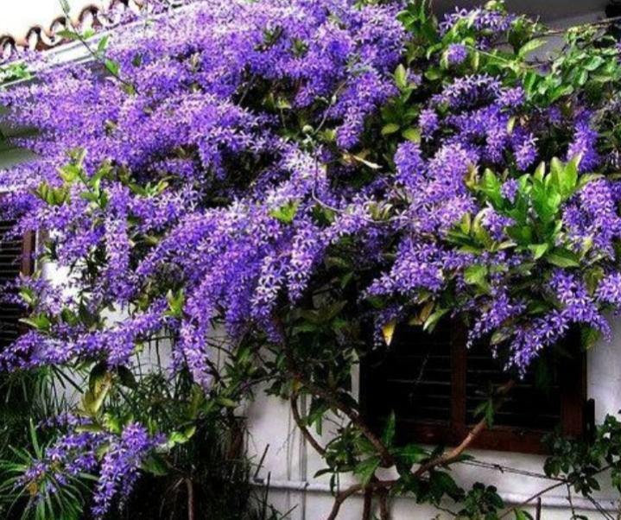
Queen’s wreath
Common name. –Purple wreath, sandpaper vine.
Botanical name- Petrea volubilis
Family – verbenaceae
Origin. - Central America
Flower colour- Purple
Flowering- April- may
Remarks –. Propagation by layering cutting
and suckers.

Slide 17
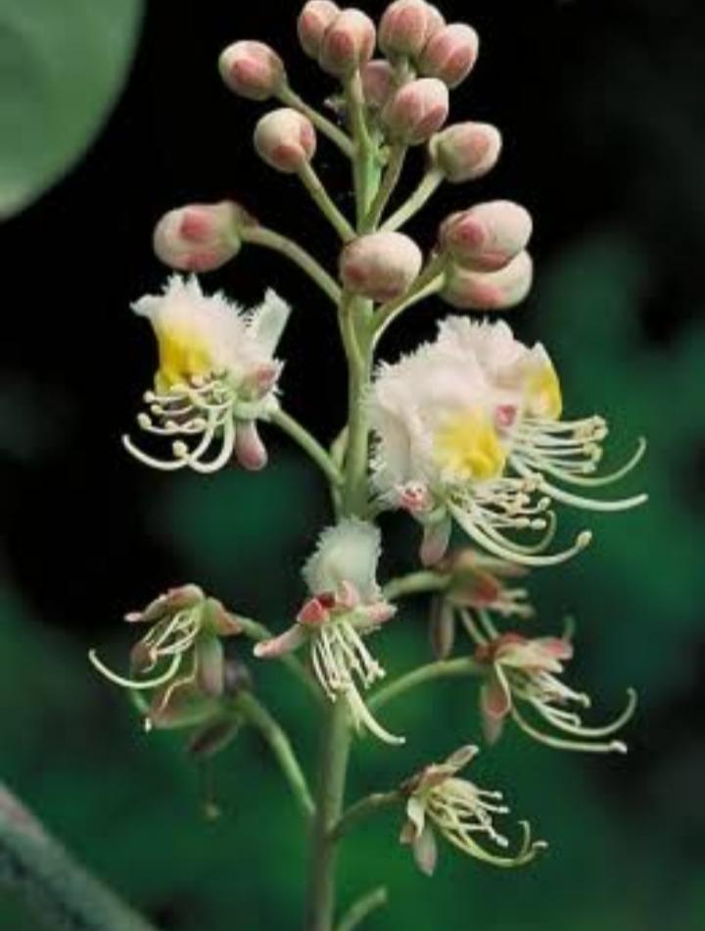
Helicopter flower hiptage
Botanical name- Hiptage benghalensis
Family- malphigiceae
Origin – India to Philippines
Flower colour – Creamish white
Flowering Feb – March
Remarks – Quick growing climber, propagation
by seed, cutting soil layering.

Slide 18
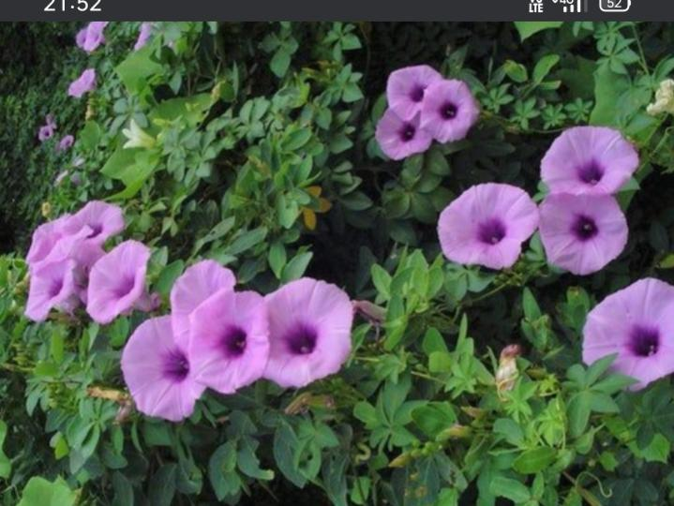
Railways creeper
Common name – Cairo morning Glory, ivy
morning glory
Botanicall name- Ipomoea cairica
Family – Convolvulaceae
Origin – tropic of both the hemisphere
Flower colour – Purple
Flowering-. throughout the year
Remarks –. quick growing climber ,for
boundary wall, Propagation by
seeds , cutting and soil layering.

Slide 19
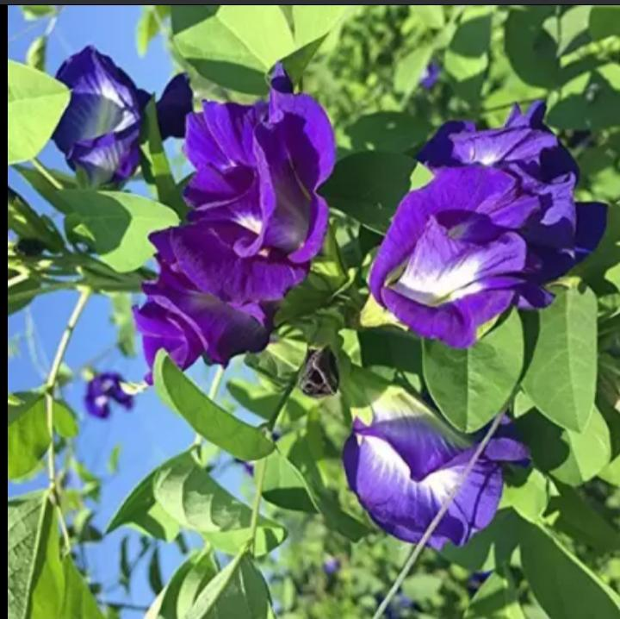
Butterfly pea
Common name- Aparjita
Botanical name- Clitoria ternatea
Family – fabaceae
Origin – subtropical Asia and America
including India
Flower colour- blue,purple ,white
Flowering – summer
Remarks-. This perennial climber can be propagated
By seeds and can also be grown in pots .

Slide 20
👉Adventages of climbers
Pace savers ,can be grown on walls, trees ,or fences.
Can be used for screening the premises for maintaining privacy.
Best ornamental plant for enhancing Beauty of any garden.
Growth and mass colour of it give pleasant apperance.
More suitable for growing on arches and pergolas.
Bare walls can be decorated.
Good source of Oxygen indoorly.
Mood changers by their colour.

Slide 21
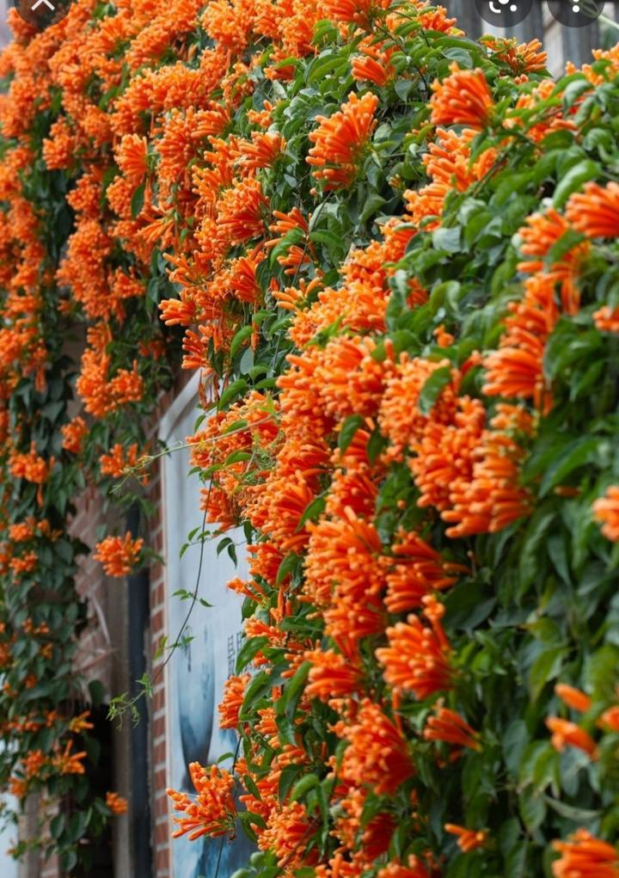
Some beautiful pictures of climbers.

Slide 22
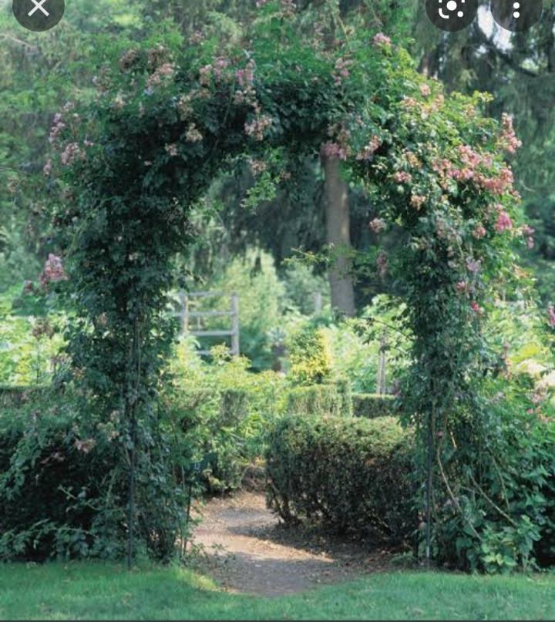
1.

Slide 23
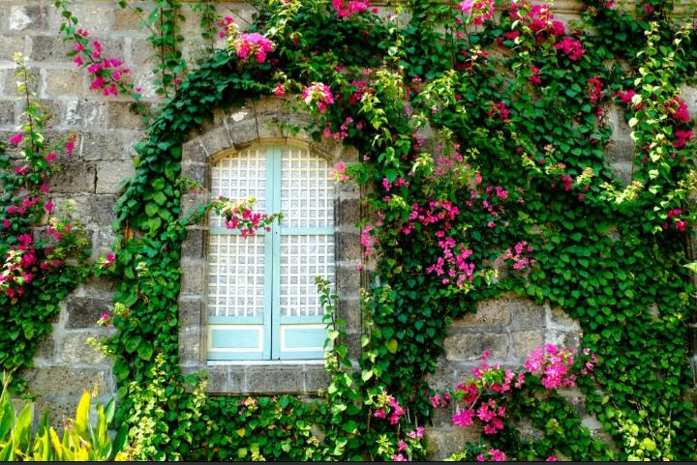

Slide 24


Slide 25
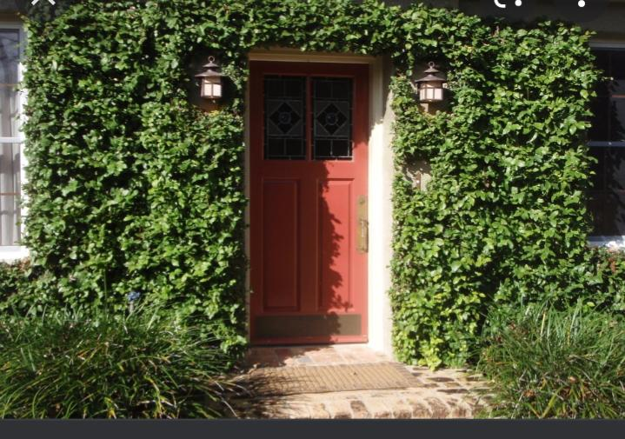

Slide 26
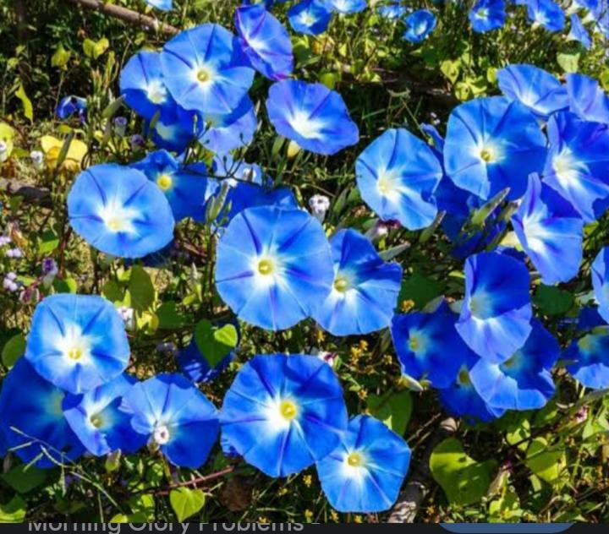
Thank you

